Slide 1
GIT

Slide 2
Agenda:
What are VCS?
What are different types of VCS?
What is GIT?
What are the different GIT Commands?

Slide 3
VCS: Version Control Systems

Slide 4
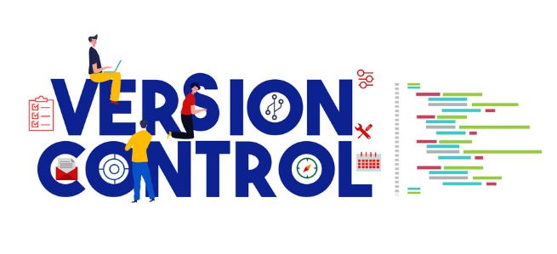
Version Control Systems:
VCS keeps track of changes made to files over time, allowing you to revert to previous versions if needed.
Multiple developers can work on the same project simultaneously, merging their changes seamlessly.
VCS allows developers to create branches to experiment with new features without affecting the main codebase, later merging changes back.

Slide 5
Types of VCS

Slide 6
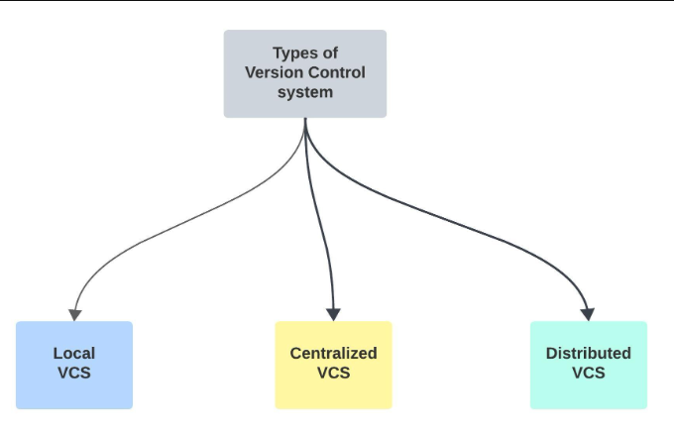
Types of VCS:
The three main types of version control systems include:
• Local Version Control System
• Centralised Version Control System
• Distributed Version Control System

Slide 7
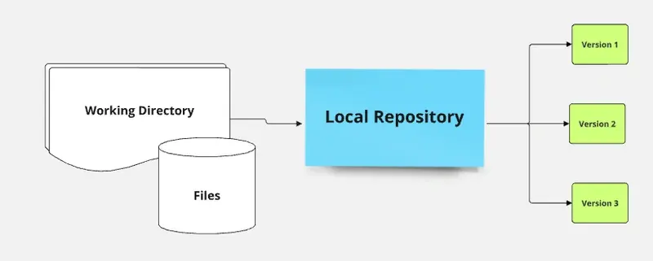
Types of VCS:
Local Version Control System:
• Local Version Control Systems (Local VCS) are tools that keep all versioning information on the same local system.
• Local VCS is designed for individual use, where all version control is managed on a single machine.
• Advantages: Easy to set up and use; no need for a network connection; minimal overhead.
• Disadvantages: Limited to individual use; lacks collaboration features; no built-in backup mechanisms.

Slide 8
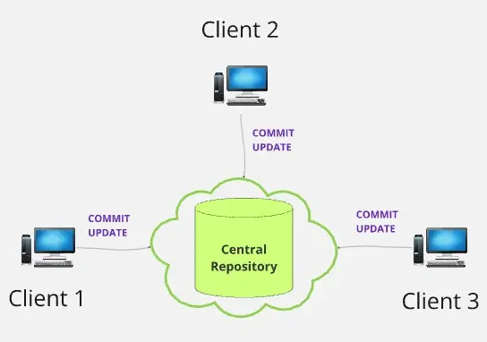
Types of VCS:
Centralised Version Control System:
• Centralized Version Control Systems (CVCS) are designed to manage version control in a central repository that multiple users can access..
• Easier to manage security and access controls since all data is stored centrally.
• Drawbacks: Can be a single point of failure. If the central server goes down, no one can collaborate. Limited offline access since changes need to be synchronized with the central repository.

Slide 9
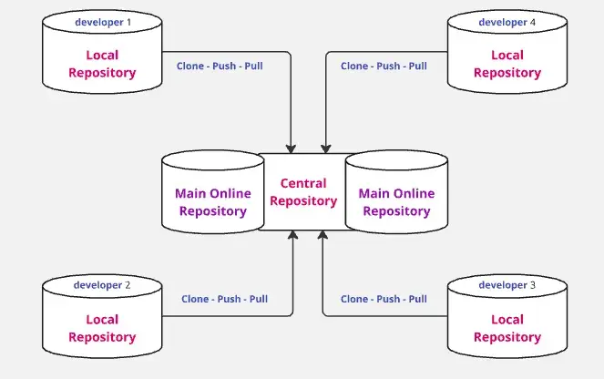
Types of VCS:
Distributed Version Control System:
• Distributed Version Control Systems (DVCS) offer a more flexible approach to version control by allowing each user to have a complete copy of the repository.
• Each user maintains their own local repository, which includes the entire history of changes.
• Since each user has a complete copy of the repository, there is no single point of failure.
• DVCS excels in merging changes from multiple users, making it easier to manage complex projects.

Slide 10
GIT

Slide 11

GIT:
• Git is a popular distributed version control system.
• It is used for:
Tracking code changes
Tracking who made changes
Coding collaboration
• Developers can work together from anywhere in the world.
• Developers can see the full history of the project.
• Developers can revert to earlier versions of a project.

Slide 12
GIT:
• Features of GIT:
• Open Source.
• Scalable.
• Speed.
• Security.
• Distributed.

Slide 13
GIT:
• Advantages of GIT:
• Saves time.
• Offline working.
• Track Changes.
• Undo Mistakes.

Slide 14
GIT Commands

Slide 15
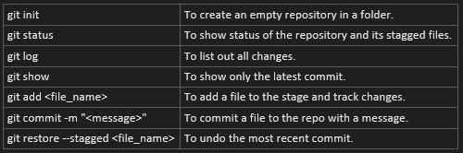
GIT Commands:

Slide 16
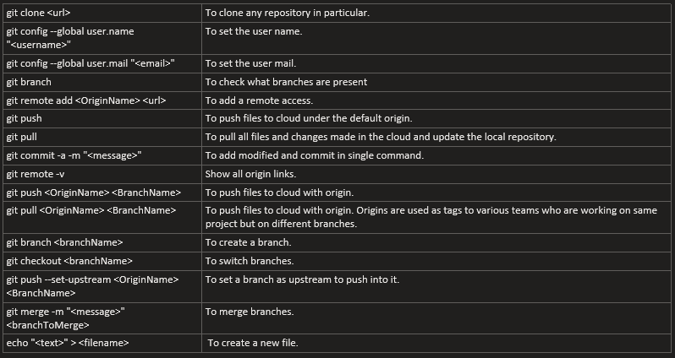
GIT Commands:

Slide 17
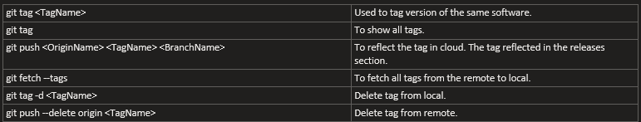
GIT Commands:

Slide 18
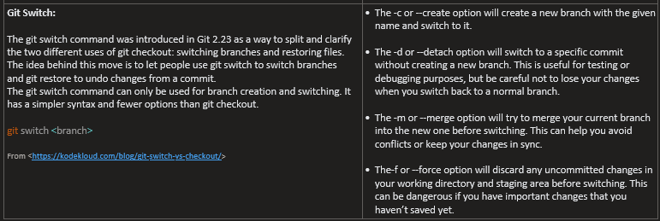
GIT Commands:

Slide 19
References:
• Git Tutorial
• Version Control System
• Git and GitHub Introduction

Slide 20
Thank You!
- Nisanth Saravanan.

